Slide 1
UDP

Slide 2
it is unreliable and connectionless protocol.
Simple protocol with minimum overhead.

Slide 3
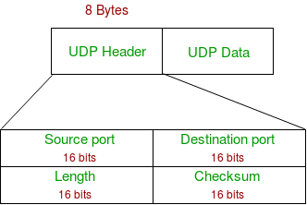
UDP Header

Slide 4
Source Port : Source Port is 2 Byte long field used to identify port number of source.
Destination Port : It is 2 Byte long field, used to identify the port of destined packet.
Length : Length is the length of UDP including header and the data. It is 16-bits field.

Slide 5
Checksum :
Checksum is 2 Bytes long field.
It is the 16-bit one’s complement of the one’s complement sum of the UDP header, pseudo header of information from the IP header and the data, padded with zero octets at the end (if necessary) to make a multiple of two octets.

Slide 6
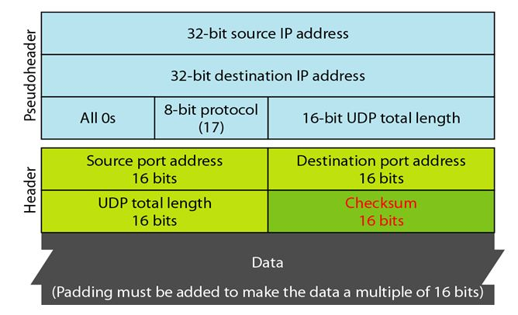

Slide 7
Use of UDP
Used for simple request response communication when size of data is less and hence there is lesser concern about flow and error control.
It is suitable protocol for multicasting ;
UDP is used for some routing update protocols like RIP(Routing Information Protocol).
Normally used for real time applications which can not tolerate uneven delays between sections of a received message.

Slide 8
Following implementations uses UDP as a transport layer protocol:
NTP (Network Time Protocol)
DNS (Domain Name Service)
BOOTP, DHCP.
NNP (Network News Protocol)
Quote of the day protocol
TFTP, RTSP, RIP, OSPF.
Application layer can do some of the tasks through UDP
Trace Route
Record Route
Time stamp

Slide 9
UDP operations
Udp uses concepts common to transport layer
Connectionless Services :
Each user datagram sent by udp is an independent datagram.
The user datagram are not numbered.
They can travel on a different path

Slide 10
Flow control and error control
No flow control hence no window mechanism.
No error control mechanism except for the checksum.
Sender doesn’t know if a message has been lost or damaged or duplicated.
When receiver detect an error through the checksum ,the datagram is discarded.
Encapsulation and Decapsulation
To send a message from one process to another ,Udp protocol
encapsulates and decapsulates messages in an IP datagram.

Slide 11
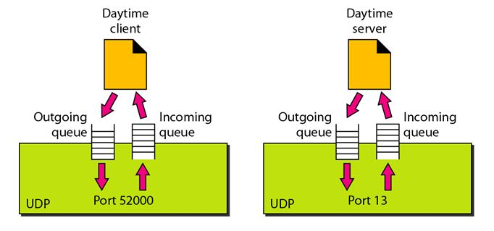
Queuing:

Slide 12
When a process starts, it requests a port number from the operating system.
create both an incoming and an outgoing queue associated with each process.
The client process can send messages to the outgoing queue by using the source port number specified in the request.
UDP removes the messages one by one and, after adding the UDP header, delivers them to IP.
When a message arrives for a client, UDP checks to see if an incoming queue has been created for the port number specified in the destination port number field of the user datagram.

Slide 13
If there is such a queue, UDP sends the received user datagram to the end of the queue.
If there is no such queue, UDP discards the user datagram and asks the ICMP protocol to send a port unreachable message to the server.
At the server site, a server asks for incoming and outgoing queues, using its well-known port, when it starts running.
The queues remain open as long as the server is running.
When a message arrives for a server, UDP checks to see if an incoming queue has been created for the port number specified in the destination port number field of the user datagram.
If there is such a queue, UDP sends the received user datagram to the end of the queue.

Slide 14
When a server wants to respond to a client, it sends messages to the outgoing queue, using the source port number specified in the request.
UDP removes the messages one by one and, after adding the UDP header, delivers them to IP.

Slide 15
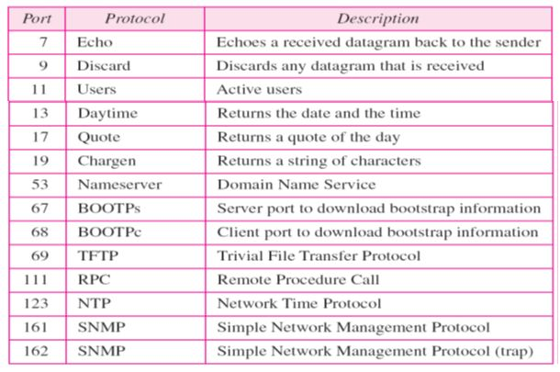

Slide 17
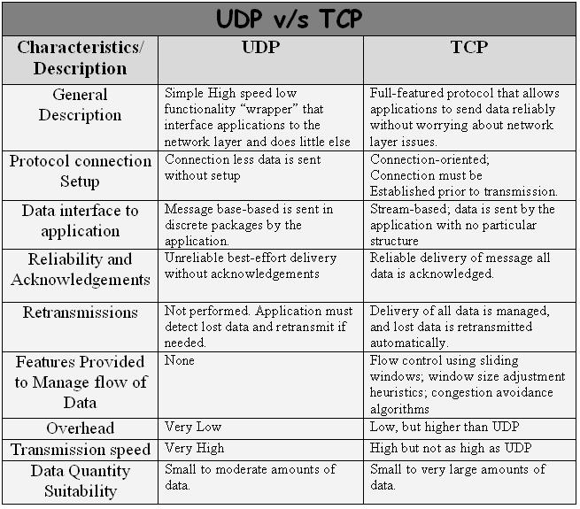

Slide 18
